Slide 1



MCSE 666:Pattern and Speech Recognition
Classification with Decision Trees
Dr. Md. Aminul Haque Akhand Dept. of CSE, SUB
Reference/Source Slides: Maria Simi Michael Crawford

Slide 2
Inductive Inference with Decision Trees
2
Decision Trees (DT) is one of the most widely used and practical methods of inductive inference
Features:
Method for approximating discrete-valued functions (including boolean)
Learned functions are represented as decision trees (or if-then- else rules)
Expressive hypotheses space, including disjunction
Robust to noisy data

Slide 3
Play Tennis based on Weather Condition
3
Day | Outlook | Temp | Humidity | Wind | Tennis?
D1 | Sunny | Hot | High | Weak | No
D2 | Sunny | Hot | High | Strong | No
D3 | Overcast | Hot | High | Weak | Yes
D4 | Rain | Mild | High | Weak | Yes
D5 | Rain | Cool | Normal | Weak | Yes
D6 | Rain | Cool | Normal | Strong | No
D7 | Overcast | Cool | Normal | Strong | Yes
D8 | Sunny | Mild | High | Weak | No
D9 | Sunny | Cool | Normal | Weak | Yes
D10 | Rain | Mild | Normal | Weak | Yes
D11 | Sunny | Mild | Normal | Strong | Yes
D12 | Overcast | Mild | High | Strong | Yes
D13 | Overcast | Hot | Normal | Weak | Yes
D14 | Rain | Mild | High | Strong | No

Slide 4
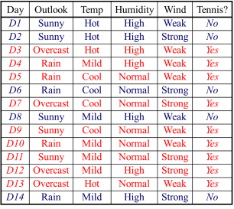
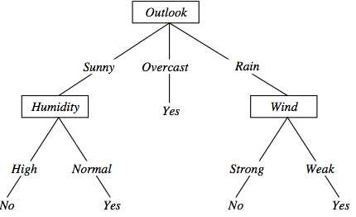
DT Representation (Play Tennis)
4
⟨Outlook=Sunny, Temp=Hot, Humidity=High, Wind=Strong⟩ No

Slide 5
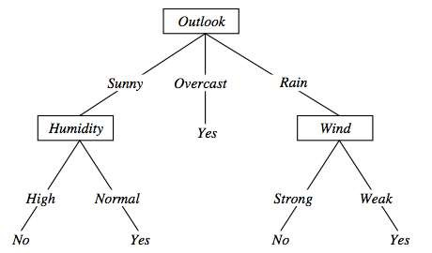
DT Expressivity
5
DTs represent a disjunction of conjunctions on constraints on the value of attributes:
(Outlook = Sunny ∧ Humidity = Normal) ∨
(Outlook = Overcast) ∨
(Outlook = Rain ∧ Wind = Weak)

Slide 6
When to use Decision Trees
6
Problem characteristics:
Instances can be described by attribute value pairs
Target function is discrete valued
Disjunctive hypothesis may be required
Possibly noisy training data samples
Robust to errors in training data
Missing attribute values
Different classification problems:
Medical diagnosis
Credit risk analysis

Slide 7
Top-Down Induction of DTs
7
ID3 (Quinlan, 1986) is a basic algorithm for learning DT's
Given a training set of examples, the algorithms for building DT
performs search in the space of decision trees
The construction of the tree is top-down. The algorithm is greedy.
The fundamental question is “which attribute should be tested next?
Which question gives us more information?”
Select the best attribute
A descendent node is then created for each possible value of this
attribute and examples are partitioned according to this value
The process is repeated for each successor node until all the examples
are classified correctly or there are no attributes left

Slide 8
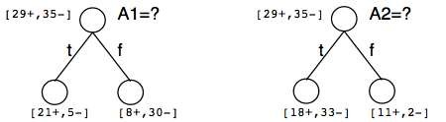
Which attribute is the best classifier?
8
A statistical property called information gain, measures how well a given attribute separates the training examples
Information gain uses the notion of entropy, commonly used in information theory
Information gain = expected reduction of entropy

Slide 9
Entropy in Binary Classification
9
Entropy measures the impurity of a collection of examples. It
depends from the distribution of the random variable p.
S is a collection of training examples
p₊ the proportion of positive examples in S
p– the proportion of negative examples in S
Entropy (S) ≡ – p₊ log₂ p₊ – p–log₂ p– [0 log₂0 = 0]
Entropy ([14+, 0–]) = – 14/14 log₂ (14/14) – 0 log₂ (0) = 0 Entropy ([9+, 5–]) = – 9/14 log₂ (9/14) – 5/14 log₂ (5/14) = 0,94 Entropy ([7+, 7– ]) = – 7/14 log₂ (7/14) – 7/14 log₂ (7/14) =
= 1/2 + 1/2 = 1 [log₂1/2 = – 1]
Note: the log of a number < 1 is negative, 0 ≤ p ≤ 1, 0 ≤ entropy ≤ 1

Slide 10
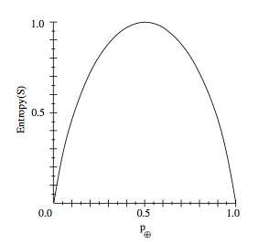
Entropy
10

Slide 11
Entropy in General
11
Entropy measures the amount of information in a random variable
For binary classification [two-valued random variable]
H(X) = – p₊ log₂ p₊ – p– log₂ p– X = {+, –}
For classification in c classes
c c
H(X) = – Σ p_{i} log₂ p_{i} = Σ p_{i} log₂ 1/ p_{i}
X = {i, …, c}
i=1 i=1
Example: rolling a die with 8, equally probable, sides
H(X) = – Σ 1/8 log₂ 1/8 = – log₂ 1/8 = log₂ 8 = 3
i=1
8

Slide 12
Entropy and Information Theory
12
Entropy specifies the number the average length (in bits) of the message needed to transmit the outcome of a random variable. This depends on the probability distribution.
Optimal length code assigns ⎡− log₂ p⎤ bits to messages with probability p. Most probable messages get shorter codes.
Example: 8-sided [unbalanced] die
1 | 2 | 3 | 4 | 5 | 6 | 7 | 8
4/16 | 4/16 | 2/16 | 2/16 | 1/16 | 1/16 | 1/16 | 1/16
2 bits | 2 bits | 3 bits | 3 bits | 4bits | 4bits | 4bits | 4bits
E = (1/4 log₂ 4) × 2 + (1/8 log₂ 8) × 2 + (1/16 log₂ 16) × 4 = 1+3/4+1 = 2,75

Slide 13
Information Gain as Entropy Reduction
13
Information gain is the expected reduction in entropy caused by
partitioning the examples on an attribute.
The higher the information gain the more effective the attribute in classifying training data.
Expected reduction in entropy knowing A
Gain(S, A) = Entropy(S) − Σ
|Sv|
Entropy(Sv)
v ∈ Values(A) ^{|S|}
Values(A) possible values for A
Sv subset of S for which A has value v

Slide 14
Example: Expected Information Gain
14
Let
Values(Wind) = {Weak, Strong}
S = [9+, 5−]
S_{Weak} = [6+, 2−]
S_{Strong} = [3+, 3−]
Information gain due to knowing Wind:
Gain(S, Wind) = Entropy(S) − 8/14 Entropy(S_{Weak}) − 6/14 Entropy(S_{Strong})
= 0,94 − 8/14 × 0,811 − 6/14 × 1,00
= 0,048

Slide 15
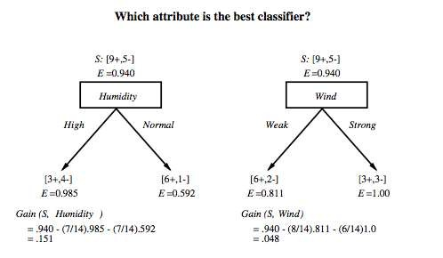
Which attribute is the best classifier?
15

Slide 16
First Step: Which Attribute to Test at the Root?
16
Which attribute should be tested at the root?
Gain(S, Outlook) = 0.246
Gain(S, Humidity) = 0.151
Gain(S, Wind) = 0.084
Gain(S, Temperature) = 0.029
Outlook provides the best prediction for the target
Lets grow the tree:
add to the tree a successor for each possible value of Outlook
partition the training samples according to the value of Outlook

Slide 17
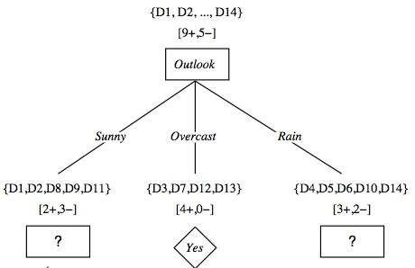
After First Step
17

Slide 18
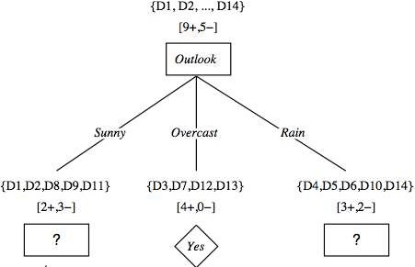
Second Step
18
Outlook={Sunny, Overcast, Rain}
Working on Outlook=Sunny node:
Gain(S_{Sunny}, Humidity) = 0.970 − 3/5 × 0.0 − 2/5 × 0.0 = 0.970 Gain(S_{Sunny}, Wind) = 0.970 − 2/5 × 1.0 − 3.5 × 0.918 = 0 .019 Gain(S_{Sunny}, Temp.) = 0.970 − 2/5 × 0.0 − 2/5 × 1.0 − 1/5 × 0.0 = 0.570
Humidity provides the best prediction for the target
Lets grow the tree:
add to the tree a successor for each possible value of Humidity
partition the training samples according to the value of Humidity

Slide 19
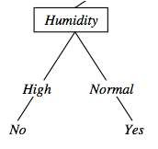
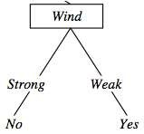
Second and Third steps
19
{D1, D2, D8}
No
{D9, D11}
Yes
{D4, D5, D10}
Yes
{D6, D14}
No

Slide 20
ID3: Algorithm
20
ID3(X, T, Attrs)
X: training examples:
T: target attribute (e.g. PlayTennis),
Attrs: other attributes, initially all attributes
Create Root node
If all X's are +, return Root with class +
If all X's are –, return Root with class –
If Attrs is empty return Root with class most common value of T in X else
A ← best attribute; decision attribute for Root ← A
For each possible value v_{i} of A:
add a new branch below Root, for test A = v_{i}
X_{i} ← subset of X with A = v_{i}
If X_{i} is empty then add a new leaf with class the most common value of T in X
else add the subtree generated by ID3(X_{i}, T, Attrs − {A})
return Root

Slide 21
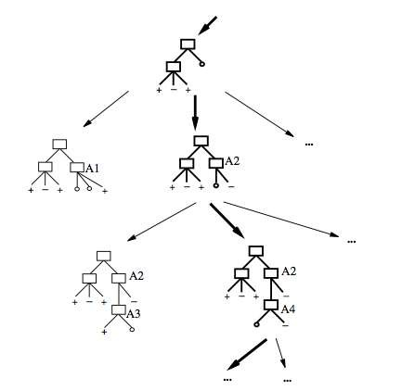
Search Space in DT Learning
21
The search space is made by partial decision trees
The algorithm is hill-climbing
The evaluation function is
information gain
The hypotheses space is complete (represents all discrete-valued functions)
The search maintains a single
current hypothesis
No backtracking; no guarantee
of optimality
It uses all the available examples (not incremental)
May terminate earlier, accepting
noisy classes

Slide 22
Inductive Bias in DT Learning
22
What is the inductive bias of DT learning?
Shorter trees are preferred over longer trees
Not enough. This is the bias exhibited by a simple breadth first algorithm generating all DT's e selecting the shorter one
Prefer trees that place high information gain attributes
close to the root
Note: DT's are not limited in representing all possible
functions

Slide 23
Two Kinds of Biases
23
Preference or search biases (due to the search strategy)
ID3 searches a complete hypotheses space; the
search strategy is incomplete
Restriction or language biases (due to the set of
hypotheses expressible or considered)
Candidate-Elimination searches an incomplete
hypotheses space; the search strategy is complete
A combination of biases in learning a linear combination of weighted features in board games.

Slide 24
Prefer shorter hypotheses: Occam's rasor
24
Why prefer shorter hypotheses?
Arguments in favor:
There are fewer short hypotheses than long ones
If a short hypothesis fits data unlikely to be a coincidence
Elegance and aesthetics
Arguments against:
Not every short hypothesis is a reasonable one.
Occam's razor:"The simplest explanation is usually the best one."
a principle usually (though incorrectly) attributed14th-century English logician and Franciscan friar, William of Ockham.
lex parsimoniae ("law of parsimony", "law of economy", or "law of succinctness")
The term razor refers to the act of shaving away unnecessary assumptions to get to the simplest explanation.

Slide 25
Issues in DTs Learning
25
Overfitting
Reduced error pruning
Rule post-pruning
Extensions
Continuous valued attributes
Alternative measures for selecting attributes
Handling training examples with missing attribute values
Handling attributes with different costs
Improving computational efficiency
Most of these improvements in C4.5 (Quinlan, 1993)

Slide 26
Overfitting in DTs
26
Building DTs that “adapt too much” to the training examples may lead to “overfitting”.
Consider error of hypothesis h over
training data: error_{D}(h)
entire distribution X of data: error_{X}(h)
empirical error expected error
Hypothesis h overfits training data if there is an alternative hypothesis h' ∈ H such that
error_{D}(h) < error_{D}(h’) and error_{X}(h’) < error_{X}(h)
i.e. h’ behaves better over unseen data

Slide 27
27
 | Example
 |  | Day | Outlook | Temp | Humidity | Wind | Tennis?
 |  | D1 | Sunny | Hot | High | Weak | No
 |  | D2 | Sunny | Hot | High | Strong | No
 |  | D3 | Overcast | Hot | High | Weak | Yes
 |  | D4 | Rain | Mild | High | Weak | Yes
 |  | D5 | Rain | Cool | Normal | Weak | Yes
 |  | D6 | Rain | Cool | Normal | Strong | No
 |  | D7 | Overcast | Cool | Normal | Strong | Yes
 |  | D8 | Sunny | Mild | High | Weak | No
 |  | D9 | Sunny | Cool | Normal | Weak | Yes
 |  | D10 | Rain | Mild | Normal | Weak | Yes
 |  | D11 | Sunny | Mild | Normal | Strong | Yes
 |  | D12 | Overcast | Mild | High | Strong | Yes
 |  | D13 | Overcast | Hot | Normal | Weak | Yes
 |  | D14 | Rain | Mild | High | Strong | No
 |  | D15 Sunny Hot Normal Strong No

Slide 28
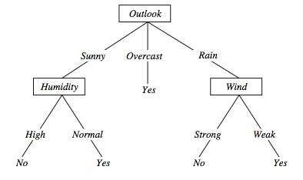
Overfitting in DTs
28
⟨Outlook=Sunny, Temp=Hot, Humidity=Normal, Wind=Strong, PlayTennis=No ⟩
New noisy example causes splitting of second leaf node.

Slide 29
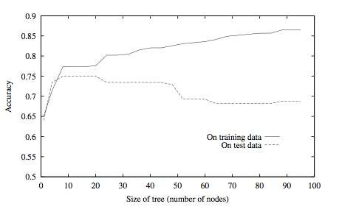
Overfitting in DTs
29

Slide 30
Avoid Overfitting in DTs
30
Two strategies:
Stop growing the tree earlier, before perfect classification
Allow the tree to overfit the data, and then post-prune the tree
Training and validation set
split the training in two parts (training and validation) and use validation to assess the utility of post-pruning
Reduced error pruning
Rule pruning
Other approaches
Use a statistical test to estimate effect of expanding or pruning Minimum description length principle: uses a measure of complexity of encoding the DT and the examples, and halt growing the tree when this encoding size is minimal

Slide 31
Reduced-error Pruning (Quinlan 1987)
31
Each node is a candidate for pruning
Pruning consists in removing a subtree rooted in a node: the node becomes a leaf and is assigned the most common classification
Nodes are removed only if the resulting tree performs no worse on the validation set.
Nodes are pruned iteratively: at each iteration the node whose removal most increases accuracy on the validation set is pruned.
Pruning stops when no pruning increases accuracy

Slide 32
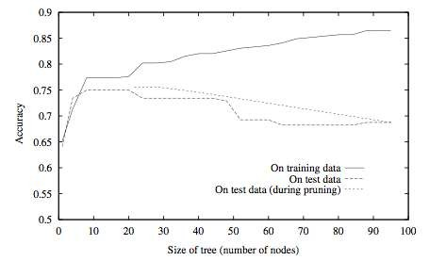
Effect of Reduced Error Pruning
32

Slide 33
Rule Post-Pruning
33
Create the decision tree from the training set
Convert the tree into an equivalent set of rules
Each path corresponds to a rule
Each node along a path corresponds to a pre-condition
Each leaf classification to the post-condition
Prune (generalize) each rule by removing those preconditions whose removal improves accuracy …
… over validation set
… over training with a pessimistic, statistically inspired, measure
Sort the rules in estimated order of accuracy, and consider them in sequence when classifying new instances

Slide 34
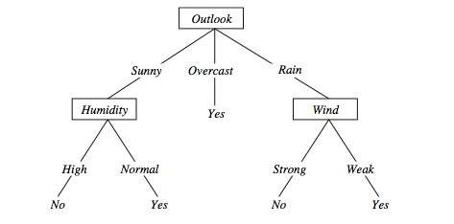
Converting to Rules
34
(Outlook=Sunny)∧(Humidity=High) ⇒ (PlayTennis=No)

Slide 35
Why Converting to Rules?
35
Each distinct path produces a different rule: a condition removal may be based on a local (contextual) criterion. Node pruning is global and affects all the rules
In rule form, tests are not ordered and there is no book-
keeping involved when conditions (nodes) are removed
Converting to rules improves readability for humans

Slide 36
Dealing with Continuous-valued Attributes
36
So far discrete values for attributes and for outcome.
Given a continuous-valued attribute A, dynamically create a
new attribute A_{c}
A_{c} = True if A < c, False otherwise
How to determine threshold value c ?
Example. Temperature in the PlayTennis example
Sort the examples according to Temperature
Temperature | 40 | 48 | | | 60 | 72 | 80 | | 90
PlayTennis | No | No | 54 | Yes | Yes | Yes | 85 No
Determine candidate thresholds by averaging consecutive values where
there is a change in classification: (48+60)/2=54 and (80+90)/2=85
Evaluate candidate thresholds (attributes) according to information gain. The best is Temperature_{>54}.The new attribute competes with the other ones

Slide 37
Handling Incomplete Training Data
37
How to cope with the problem that the value of some attribute
may be missing?
Example: Blood-Test-Result in a medical diagnosis problem
The strategy: use other examples to guess attribute
Assign the value that is most common among the training examples at
the node
Assign a probability to each value, based on frequencies, and assign
values to missing attribute, according to this probability distribution
Missing values in new instances to be classified are treated accordingly, and the most probable classification is chosen (C4.5)

Slide 38
Reference and Software
38
Important Reference: Machine Learning, Tom Mitchell, Mc
Graw-Hill International Editions, 1997 (Cap 3).
In R:
Packages tree and rpart
C4.5:
http://www.cse.unwe.edu.au/~quinlan
Weka
http://www.cs.waikato.ac.nz/ml/weka

Slide 39
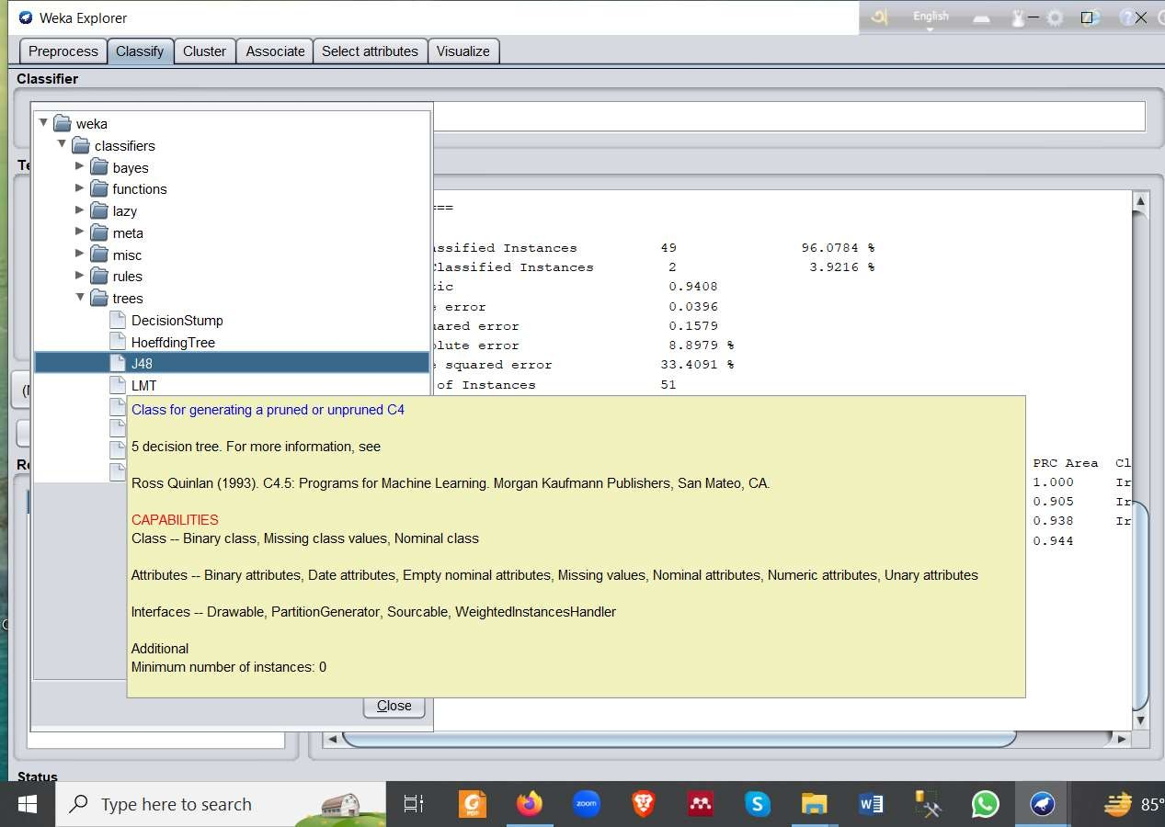
DT for Iris Dataset in Weka J48 (C4.5)
39

Slide 40
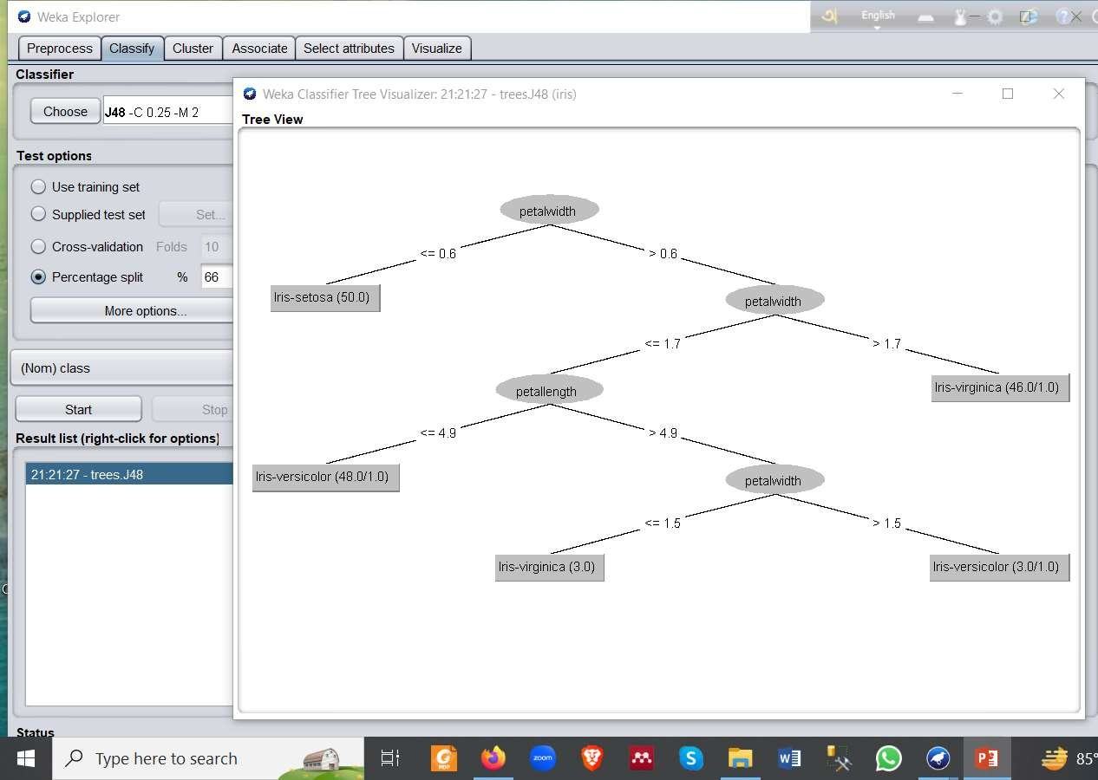
DT for Iris Dataset in Weka J48 (C4.5)
40

Slide 41
Open Discussion
41

Slide 42
An alternative measure: gain ratio
c |S_{i} | |S_{i} |
SplitInformation(S, A) ≡ − Σ
log₂
i=1 |S | |S |
S_{i} are the sets obtained by partitioning on value i of A
SplitInformation measures the entropy of S with respect to the values of A. The
more uniformly dispersed the data the higher it is.
Gain(S, A)
GainRatio(S, A) ≡
SplitInformation(S, A)
GainRatio penalizes attributes that split examples in many small classes such as
Date. Let |S |=n, Date splits examples in n classes
SplitInformation(S, Date)= −[(1/n log₂ 1/n)+…+ (1/n log₂ 1/n)]= −log₂1/n =log₂n
Compare with A, which splits data in two even classes:
SplitInformation(S, A)= − [(1/2 log₂1/2)+ (1/2 log₂1/2) ]= − [− 1/2 −1/2]=1
11/26/2023
Maria Simi

Slide 43
Adjusting gain-ratio
Problem: SplitInformation(S, A) can be zero or very small
when |S_{i} | ≈ |S | for some value i
To mitigate this effect, the following heuristics has been used:
compute Gain for each attribute
apply GainRatio only to attributes with Gain above average
Other measures have been proposed:
Distance-based metric [Lopez-De Mantaras, 1991] on the partitions of
data
Each partition (induced by an attribute) is evaluated according to the
distance to the partition that perfectly classifies the data.
The partition closest to the ideal partition is chosen
11/26/2023
Maria Simi

Slide 44
Handling attributes with different costs
Instance attributes may have an associated cost: we would prefer decision trees that use low-cost attributes
ID3 can be modified to take into account costs:
(1990)
Gain²(S, A)
1. Tan and Schlimmer
Cost(S, A)
2. Nunez (1988)
₂Gain(S, A)
− 1
(Cost(A) + 1)^{w}
w ∈ [0,1]
11/26/2023
Maria Simi

